Slide 1

WELCOME TO THE ELEMENTARY EDUCATION PROGRAM REVIEW WORKSHOP
Wi-Fi: ORU-Student
SPONSOR: Office of Educational Quality and Accountability
HOST: Oral Roberts University
Notes:
Logistics - welcome, food, restrooms, etc.
As you may be aware Elementary Education no longer has a national SPA and CAEP has recently approved standards for use in elementary programs. CAEP requires institutions to use the Program Review with Feedback option to have their elementary education programs reviewed. However, Oklahoma has not approved the Program Review with Feedback option at this time. Which means all elementary education programs will become a state level review process. Please welcome Renee Launey-Rodolf, Director and Angie Bookout, Senior Coordinator for the Office of Educational Quality and Accountability to discuss to the logistics of how the state process for reviewing the program reports will work.

Slide 2

Renée Launey-Rodolf,
Director
Angie Bookout,
Senior Coordinator
Office of Educational Quality and Accountability

Slide 3


PART I:
Unpacking the Standards
3

Slide 4

CAEP K-6 Elementary Teacher Preparation Standards
Timeline:
Transition:
Summer 2018: The CAEP 2018 K-6 Elementary Teacher Preparation Standards adopted.
Summer 2018- Spring 2019: EPPs adopt standards to make curriculum changes (if necessary).
Fall 2018 through Fall 2019: EPPs can use the 2007 ACEI Standards for submitting initial review, response to conditions, and revised reports.
Spring 2020: EPPs can use the 2007 ACEI Standards for submitting only response to conditions and revised reports. Initial review will not be conducted using these standards.
4
Notes:
After Fall 2020, CAEP is planning to sunset the 2007 ACEI Standards
This means you have to begin planning now in order to have two applications of assessment data

Slide 5

CAEP 2018 K-6 Elementary Teacher Preparation Standards
Council for the Accreditation of Educator Preparation
Notes:
The development of the standards (see pages. 80-81)
There are five K-6 Elementary Teacher Preparation Standards comprised of 23 components.
Several other sets of standards undergird the recommendations and knowledge base for the Standards including (a) the National Board for Professional Teaching Standards’ Early Childhood Generalist Standards for teachers of students ages 3-8 and (b) the NBPTS Middle Childhood Generalist Standards for students ages 7-12; (c) the NAEYC Standards for Early Childhood Professional Preparation; and (d) the InTASC Model Core Teaching Standards.
Standard 2: Drawing on Interstate Teacher Assessment and Support Consortium (InTASC), The International
Literacy Association (ILA), The National Science Teachers Association (NSTA), The National Council
for Social Studies (NCSS), The National Council of Teachers of Mathematics (NCTM), National Association for the Education of Young Children (NAEYC), and National Board for Professional
Teaching Standards (NBPTS),

Slide 6

6
Notes:
First, at the top of the pyramid is the Title of the Standard encompassing the primary focus and content of the standard
2. The second and more specific layer of the pyramid is the Standard Statement, a concise, coherent statement of candidate knowledge and skills emphasizing what candidates have students do and focusing on student learning.
3. A third part of the CAEP 2018 K-6 Elementary Teacher Preparation Standards are the Components. The Components expand upon the standard statement; they are a conceptual outline for the standard statement; they provide structure for the standard.
4. The fourth and foundational portion of each K-6 Elementary Teacher Preparation Standard is the Supporting Explanation. The supporting explanation provides essential guidance to Elementary Education teacher education programs in the following areas: program curriculum planning, development of performance assessments, and creation of scoring rubrics that are aligned with the standards.
Let’s look at Standard 2 -CAEP 2018 K-6 Elementary Standards: pp. 10-20
Look at the overall standard
Look at each of the components
Take a deeper dive into the supporting Explanation
Outline specifically what candidates need to know and be able to do.
A lot of discussion around what’s currently taught in 4X12 courses and what’s needed
Great guidelines for curriculum redesign (will discuss more in part 3.
Explain how we are redesigning the 4X12

Slide 7

Activity: pp. 89 - 93
Notes:
Many of you are familiar with the ACEI Standards. Let’s take a few minutes to compare them with the CAEP 2018 Elem Standards.
What are the major differences?
What are similarities?
What are the implications, if any for your programs – a few report outs
Wrap up – 15 minute break

Slide 8


Part II:
Key Assessments
8

Slide 9


Assessing the CAEP 2018 K-6 Elementary Teacher Preparation Standards
a minimum of six and a maximum of eight assessments:
(1) a licensure assessment, or other content-based assessment; (2) content-based assessment; (3) assessment of candidate ability to plan instruction; (4) assessment of student teaching; (5) assessment of candidate effect on student learning; and (6) assessment of candidate professional learning.
9
Notes:
K-6 Elementary teacher preparation programs are strongly encouraged submit a seventh and/or eighth assessment that they believe will further strengthen their demonstration that all standards are met. The specific focus of this assessment is determined by the program’s assessment system and the extent to which stronger evidence that a standard is met is needed.

Slide 10
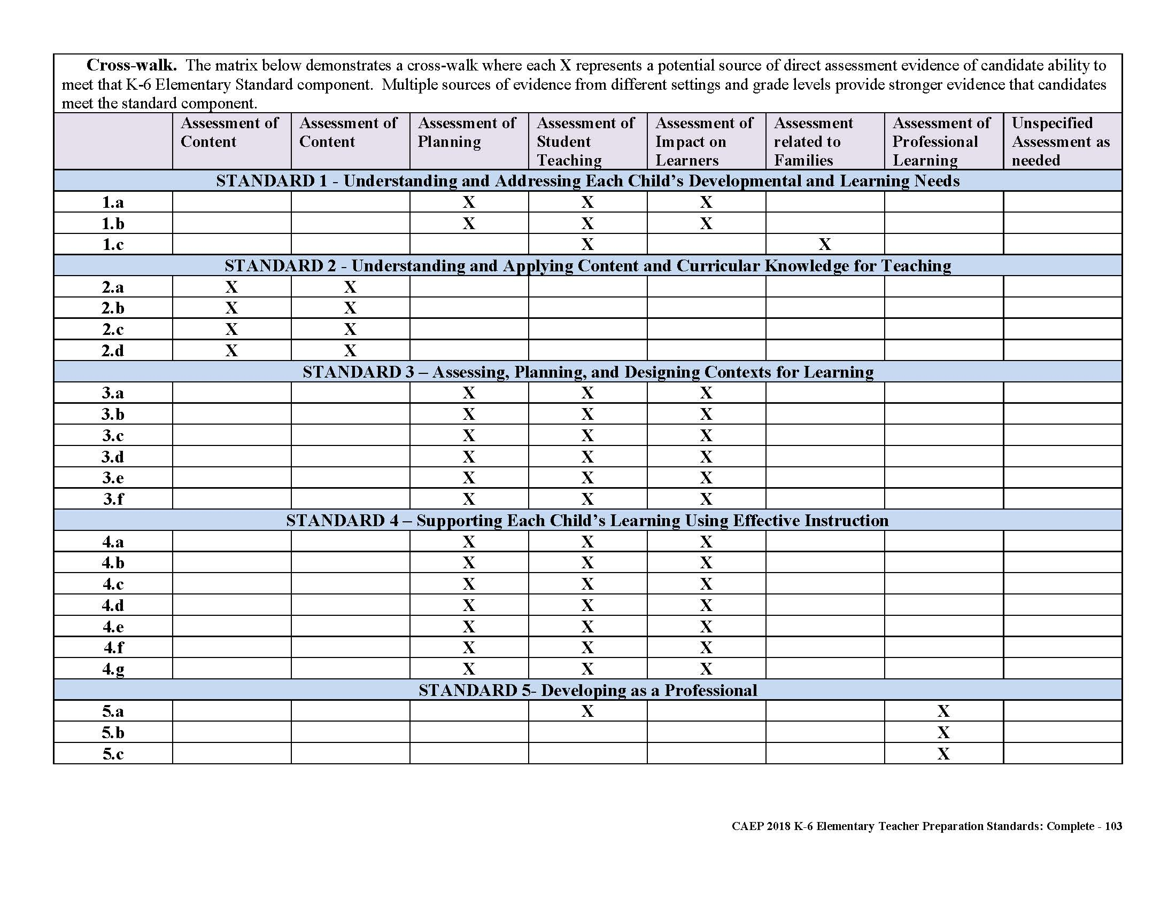
Assessment Evidence Guidelines
Notes:
Let’s look at pp. 94-102
For Each standard there is a set of sources of assessment evidence for candidate performance that can be used to address the standard.
For Standards 1, 3, and 4 ONLY:
Go through and determine of the assessments that are suggested, which do you already utilize? - we will deal with the content of the rubrics next. Just determine what assessments you have.
Let’s look at Standard 5 and the suggested assessments. What do you currently have in place?
Look at Standard 2 – Have Renee discuss OSAT content and alignment.
Discuss standard 2 as problematic if candidates can currently meet the 4 X 12 taking whatever subject area courses they want.

Slide 11


PPAT - Assessment
Activity
11
Notes:
Let’s look at the alignment of the standards with the InTASC standards (Handouts – ELE & InTASC Alignment Doc, PPAT alignment doc.)
We can see there is a clear alignment with InTASC and ELE Standards
There’s a clear alignment with the InTASC and PPAT
What ELE standards will the PPAT help you meet?
I don’t think it is very strong evidence for meeting Standard 5 – why?

Slide 12


EPP Created Assessments
CAEP Evaluation Framework
12
Notes:
I’m not going to spend a lot of time discussing this document, but EPPs will use it if they have created their own assessments AND Program Reviewers will need to use it when reviewing programs
Must be at the CAEP SUFFICIENT LEVEL!

Slide 13
Guidance for Elementary Teacher Preparation Programs and Reviewers
Preponderance of Evidence
Meeting requirements for standards and components
Evaluating alignment among standards, assessments, and rubrics
Evaluating the quality of candidate assessments
  Administration and purpose of assessments
  Informing candidates
  Content of Assessment
Evaluating the quality of the assessment rubrics
13
Notes:
See pages 104 – 106
Break 15 minutes

Slide 14
PART III:
Program Development
14

Slide 15

Steps and Tools for Program Development
Supporting Explanations
Tools for Evaluating Teacher Preparation Curriculum
Use Examples of Evidence of Candidate Competence to create assignments
Using Rubrics to assess candidates
15
Notes:
Supporting Explanations – (pp. 7-34) – provide detailed descriptions of what candidates should know.
Take a few moments to determine what courses cover the standard content? Once the courses have been identified, you can then determine if there are holes in which some of the standard components are not addressed.
Use the tools for evaluating Teacher Prep Curriculum (pp. 147-156)
Use Examples of candidate activities (see pp. 107-114) – Highlight activities you currently do. Identify some you don’t do but think they are good
Using the rubrics - (see pp. 116 – 139)
Using these tools would be a good way to ensure alignment of standards, learning activities and assessments.

Slide 16





THANK YOU
Dr. Kim Boyd
918-495-7096
kboyd@oru.edu
http://caepnet.org/accreditation/caep-accreditation/caep-k-6-elementary-teacher-standards
https://www.ets.org/ppa/test-takers/
https://www.ok.gov/oeqa/Educator_Preparation/Program_Review/index.html

